Slide 1
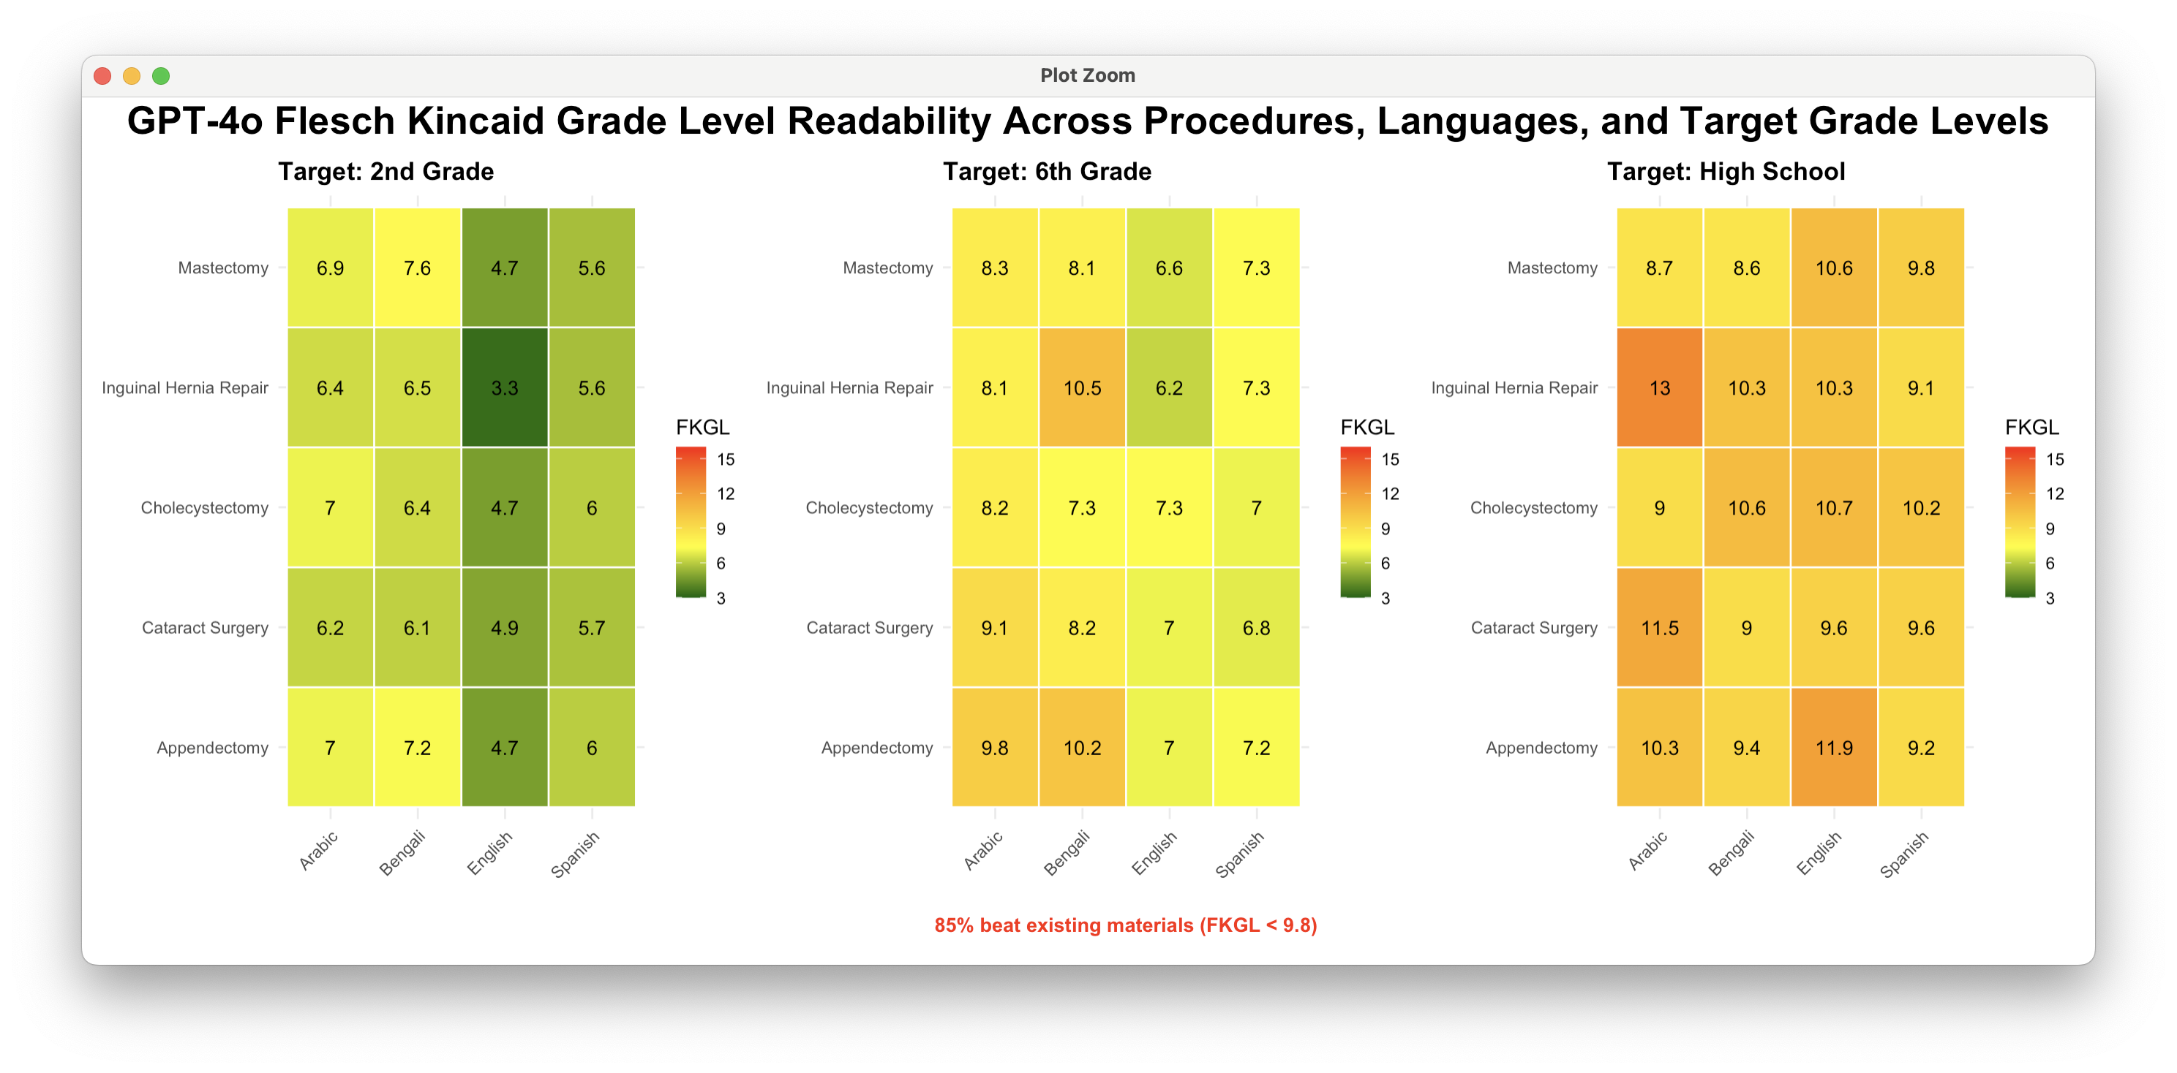
a)
b)
c)

Slide 2
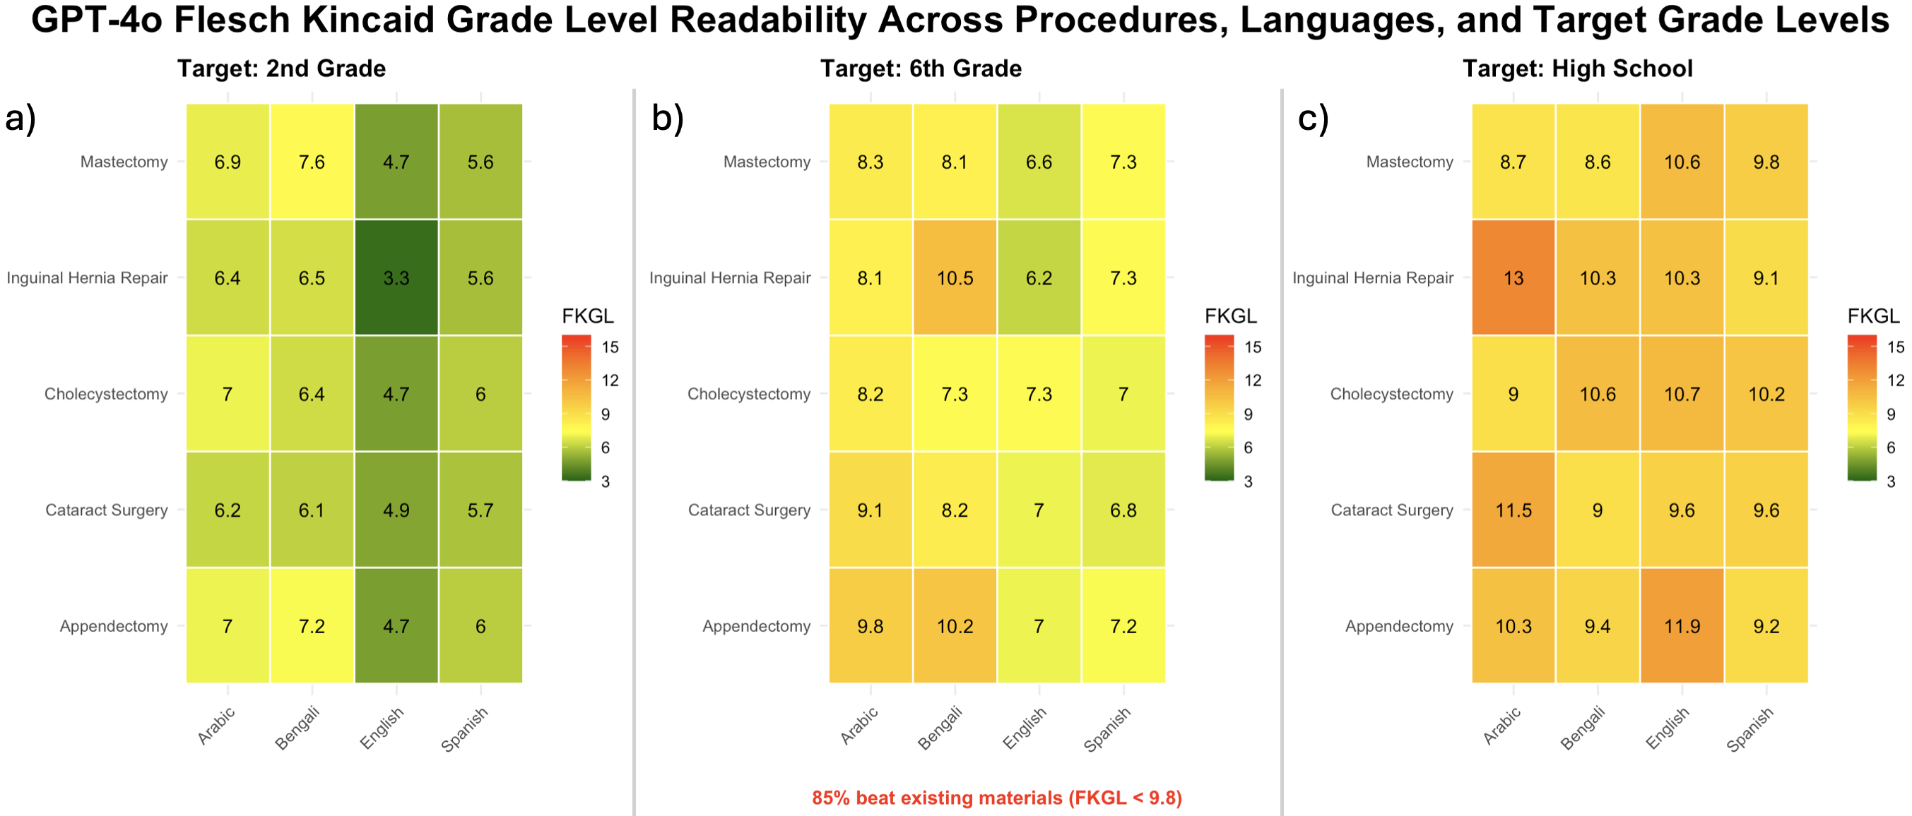
Figure 1. GPT-4o-generated perioperative instructions by procedure, language, and target reading level, evaluated using Flesch-Kincaid Grade Level (FKGL). Heatmaps display average FKGL readability scores for GPT-4o–generated perioperative instructions across four languages (Arabic, Bengali, English, Spanish) and five surgical procedures, stratified by target reading level: (a) 2nd grade, (b) 6th grade, and (c) high school. Lower FKGL values indicate easier-to-read text. Green and yellow shades represent lower complexity, while orange and red reflect increasingly difficult readability.

